Slide 1
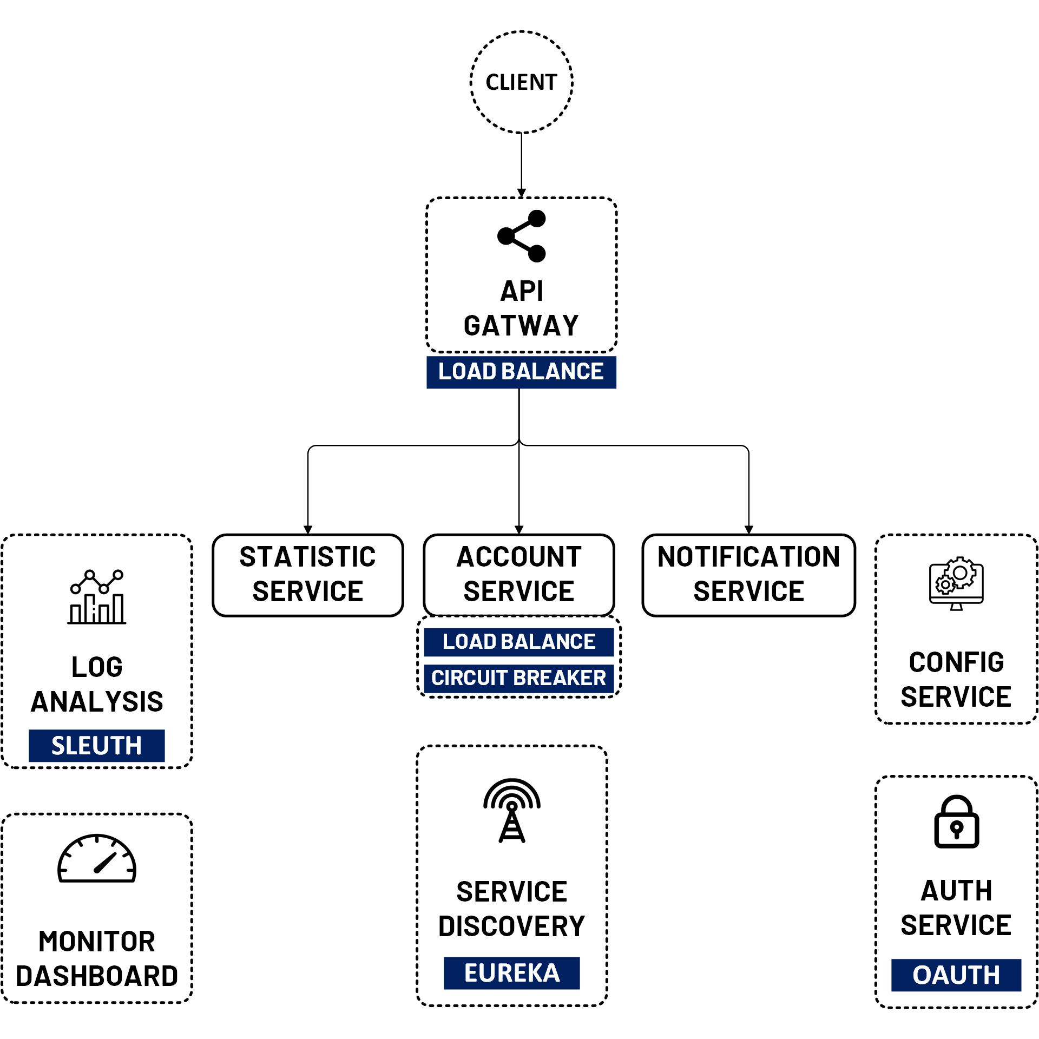

Hello!
I am JMaster.io
Find me at www.jmaster.io
Today, we learn about
Microservices with Spring Cloud & & OAuth 2 Security

